Slide 1
Sketch to Photo Translation
Yuhang Li

Slide 2
Sketch
Related works
Exploration

Slide 3
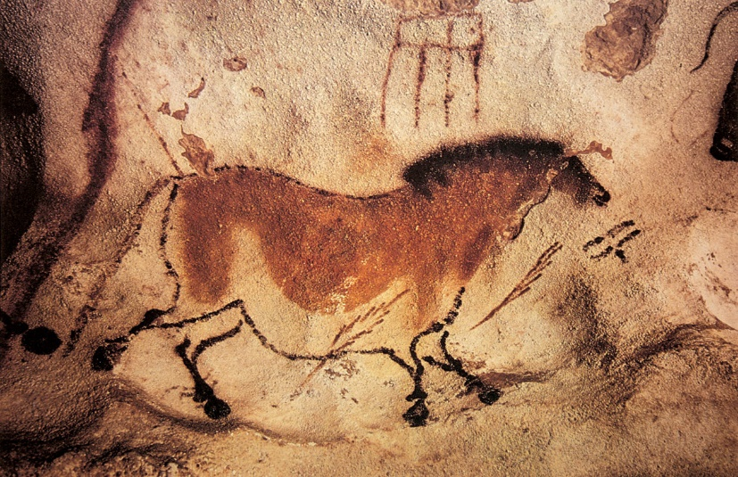
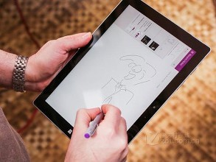
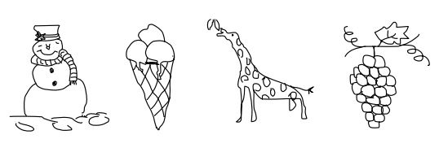
Sketch
A universal form of communication across nations and cultures
Tracing back to prehistoric cave painting
Conveying abstract concepts visually
Becoming more important due to the popularity of touch devices

Slide 4
Characteristic of Sketch
Iconic
Sketches can be highly abstract.

Slide 5
Characteristic of Sketch
High intra-class variations
Sketches drawn by different people vary in the level of abstraction or deformation.

Slide 6
Characteristic of Sketch
Lack of visual cues
Sketches are lack of colors and textures compared to photos.

Slide 7
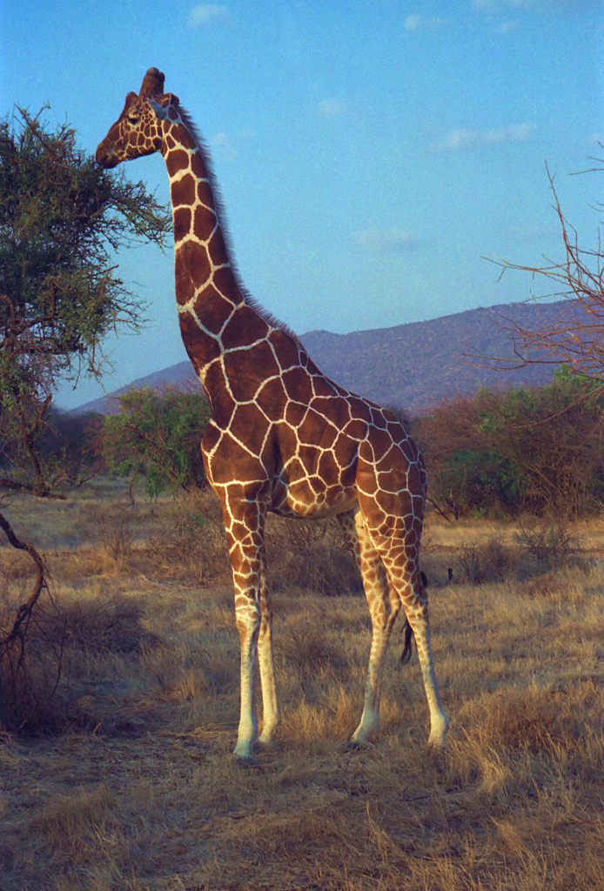
Problem definition
Sketch-based image generation
Given a sketch, we want to generate an image that preserves the scene in the sketch.
？

Slide 8
Sketch classification: SketchNet
Discover the discriminative structures of sketch images
Triplet networks based on Siamese nets
Weekly supervised
H. Zhang 2016

Slide 9
Sketch classification: Sketch-a-Net
A novel method of data augmentation
Bayesian fusion
Multiple models of different scales
Beats human in classification performance
Sketch-a-Net, Q. Yu 2016

Slide 10
Sketch-based retrieval
Sketch-based 3D model retrieval
Sketch-based image retrieval
Sketch-based fine-grain image retrieval
3D model retrieval, F. Wang et al 2015
Image retrieval, P. Sangkloy et al 2016
Fine-grain image retrieval, Q. Yu et al 2016

Slide 11
Sketch-based image generation
Edge map to photo, P. Isola et al 2016

Slide 12
Generative Adversarial Nets (GANs)
Generate images of a given dataset by adversarial training
Discriminator
Generator
Minmax game
Notes:
Discriminator
The policeman: distinguish whether an image is sampled from dataset or is generated by the generator
Generator
The thief: generate images that looks like samples of dataset to deceive the discriminator

Slide 13
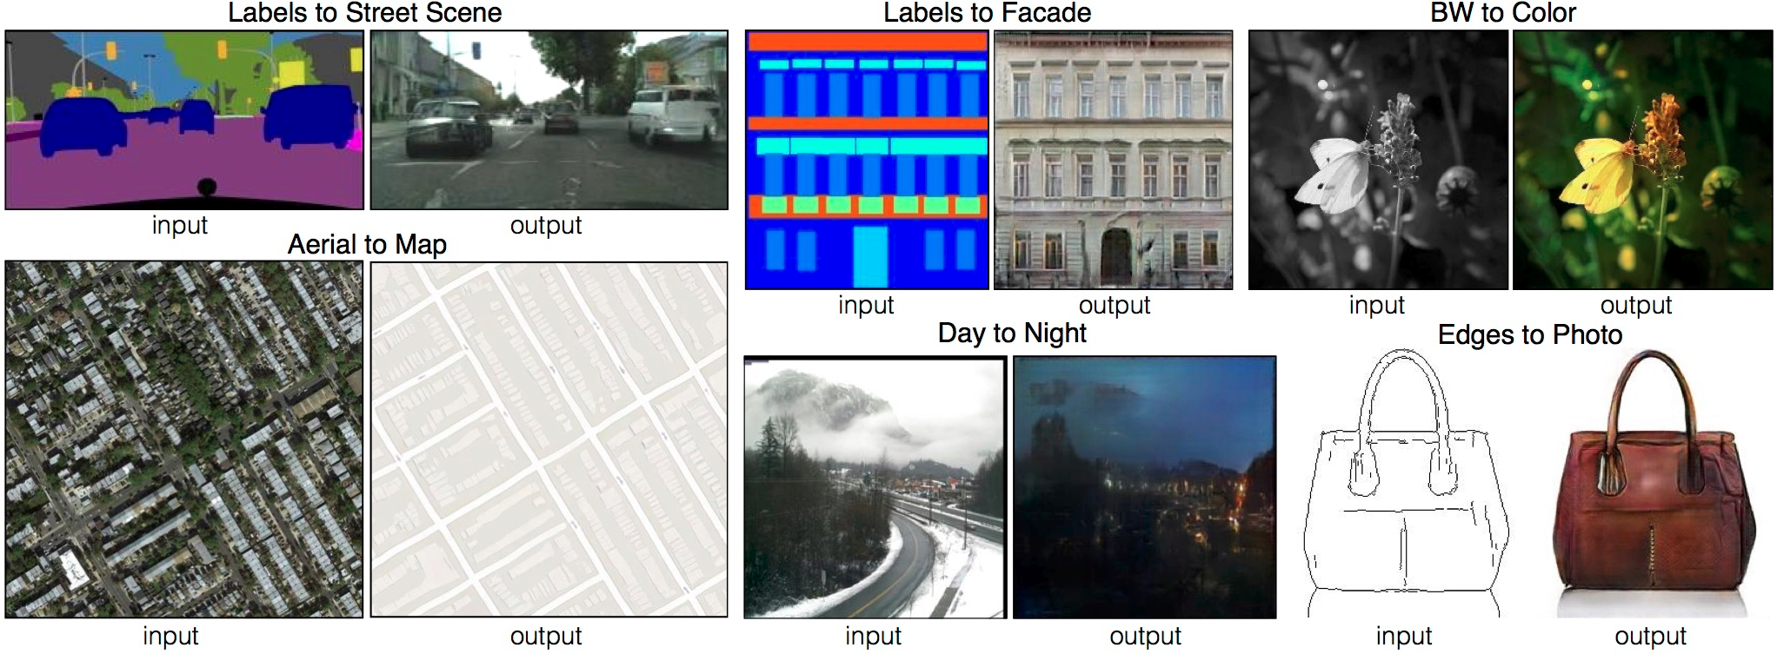
Image-to-image translation
Based on conditional GANs
Paired images for training
A framework for multiple applications, only switching the training sets
Image-to-image translation, P. Isola et al 2016

Slide 14
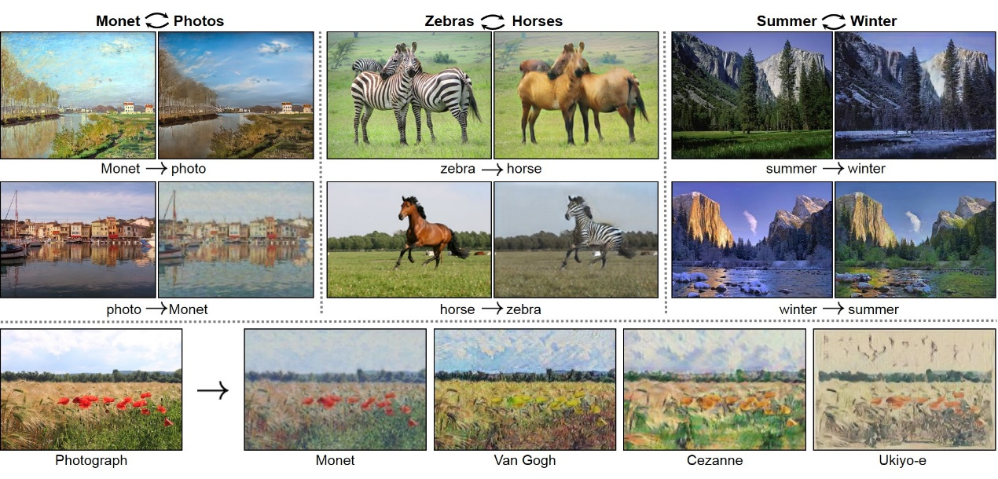
Unpaired image translation
Image-to-image translation
Unpaired images datasets
Cycle consistency
Reconstruct the input image from
generated image
CycleGAN, J. Zhu et al 2017

Slide 15
Unpaired image translation
Image-to-image translation
Unpaired images datasets
Cycle consistency
Reconstruct the input image from
generated image
DiscoGAN, T. Kim et al 2017

Slide 16
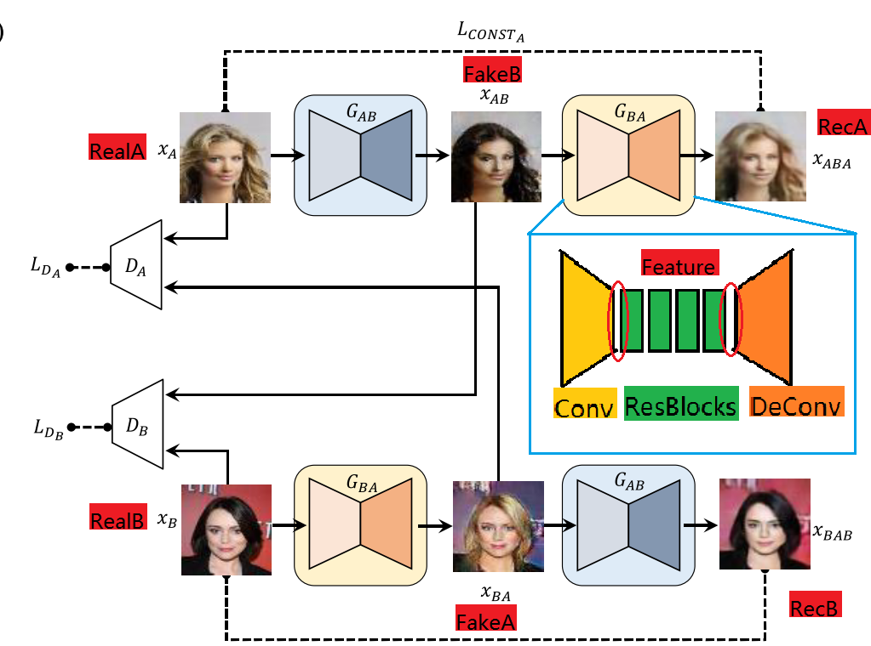
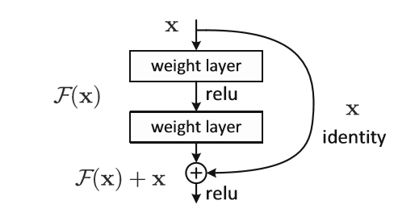
Exploration: CycleGAN
Architecture details
Residual blocks
Instance normalization
Generated image pool
Notes:
Residual blocks
In spired by Johnson et. al., in the bottleneck layers, residual blocks are added to transfer features of A image to features of B.
Instance normalization
Instance normalization is also unknown as contrast normalization. CycleGANs swap batch normalization with instance normalization in both training and testing time since we want to keep the content instead of style and contract is clearly not a part of content in the image.
Generated image pool
CycleGANs discard both random vector and drop which introduce stochasticity in the training procedure and use the historical generated images to update the discriminators by maintaining a generated image pool with size of 50. The pool is filled with first generated 50 images and updated by replacing one of randomly selected images in it with the newly generated image.

Slide 17
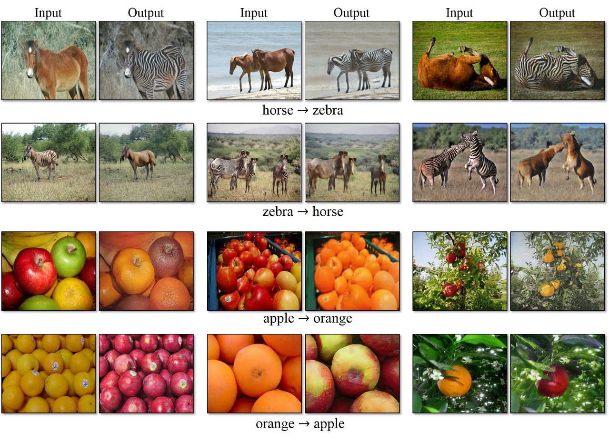
Exploration: CycleGAN
Reported results

Slide 18
Exploration: CycleGAN
Results by training after 200 epochs with the official torch implementation. Horse to zebra dataset

Slide 19
Exploration: CycleGAN
Results by training after 200 epochs with the official torch implementation. Sketch to photo (apple) dataset.
Mode collapse (sketch to photo)
All white (photo to sketch)

Slide 20
Exploration: CycleGAN
Results by training after 200 epochs with the official torch implementation. Sketch to photo (airplane) dataset.

Slide 21
Exploration: DiscoGAN

